Slide 1



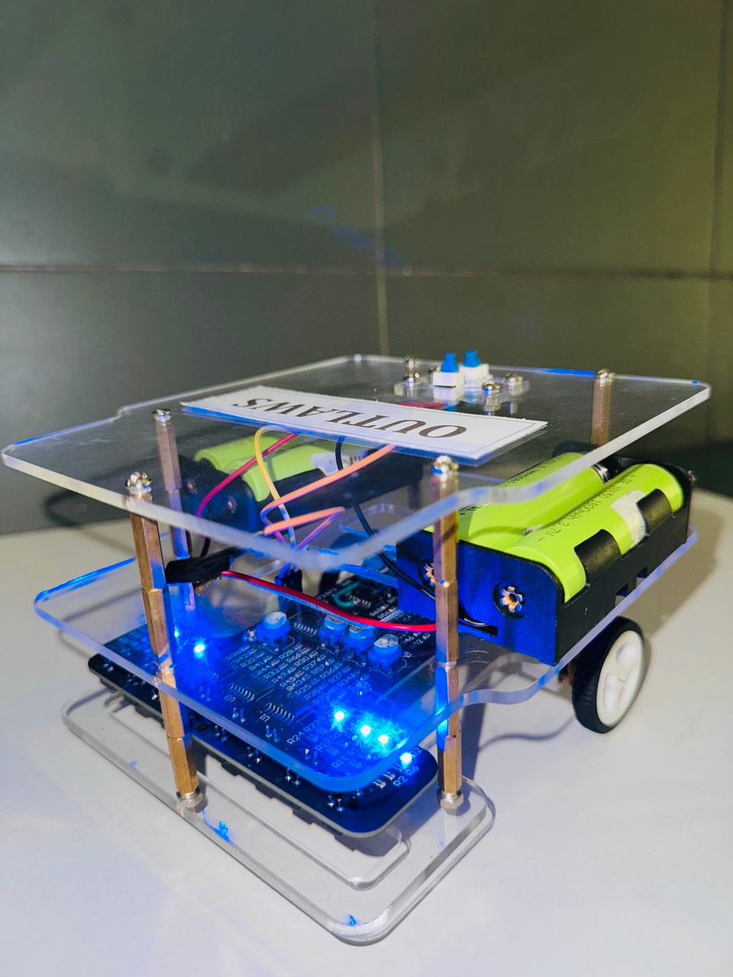


www.reallygreatsite.com
ANALOG LINE FOLLOWING ROBOT
Presented by Outlaws

Slide 2

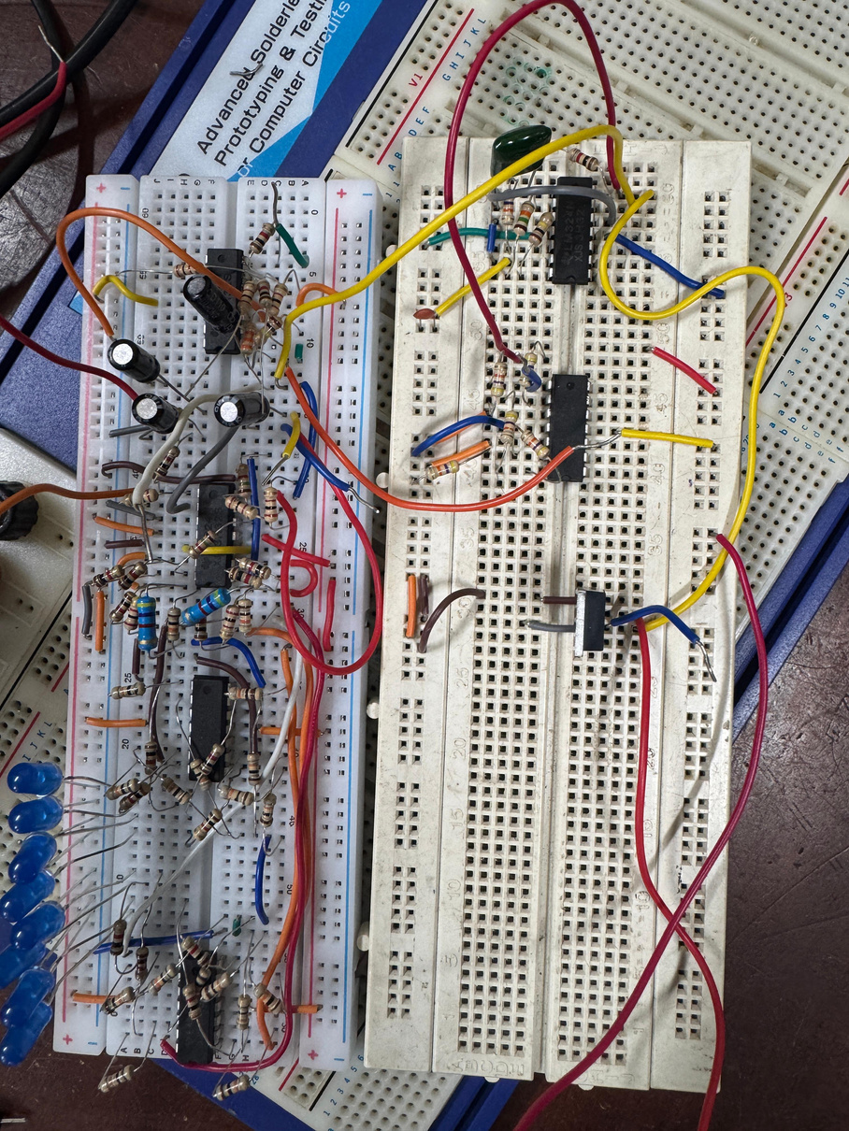

Project Overview
Fully analog line-following robot using PID control.
IR sensor array detects line position.
Analog circuits generate error and implement PID.
Comparator with triangular wave produce PWM for motor control.
Transistors drive motors for smooth, real-time line tracking.

Slide 3

Components and Selection
LM324N Op-Amp IC
IR Sensors
Resistors & Variable resistors
Contains 4 op-amps in total. Ideal for implementing P, I, D circuits and signal conditioning.
Provides accurate line position detection. Analog output simplifies processing.
Used for setting PID gains (Kp, Ki, Kd) and voltage division.
Capacitors
Buck Converter
DC Motors
Used for filtering, integration, and differentiation circuits.
The buck converter steps down the battery voltage to a stable 6 V supply, ensuring efficient and reliable power delivery to the DC motors without affecting the analog control circuits.
Provide motion to the robot and respond effectively to PWM control signals.
Voltage Regulators
3.7 V Li-ion Batteries
MOSFETs
Used to create a regulated ±5 V dual power supply for stable analog operation.
Used as the main power source. Two batteries connected in series supply sufficient voltage for both regulators to produce ±5 V.
Used as efficient electronic switches for driving DC motors with PWM signals. Offer fast switching speed and low power loss compared to BJTs.

Slide 4
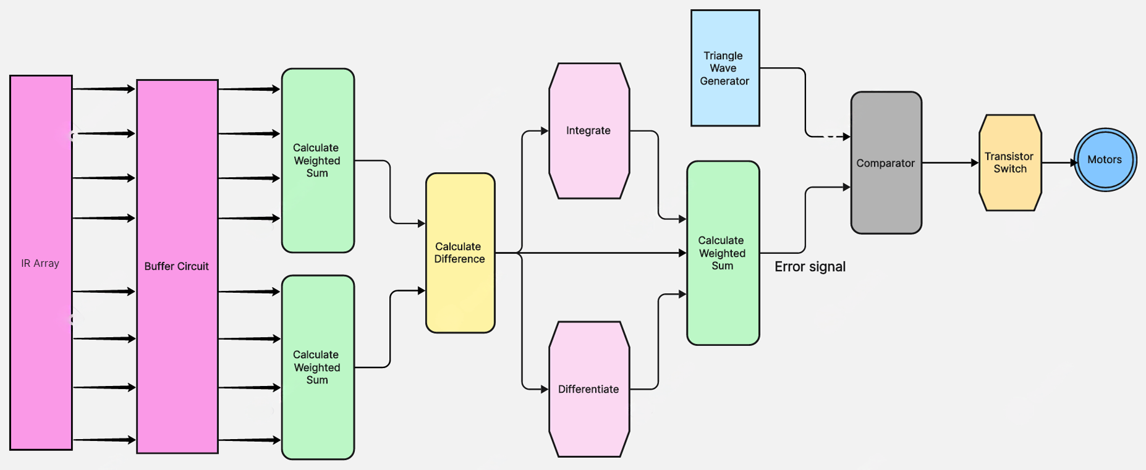
System Block Diagram
Amplifier

Slide 5
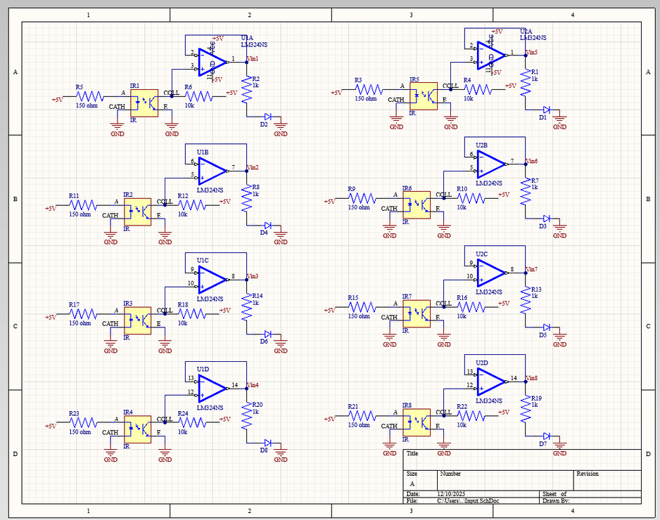
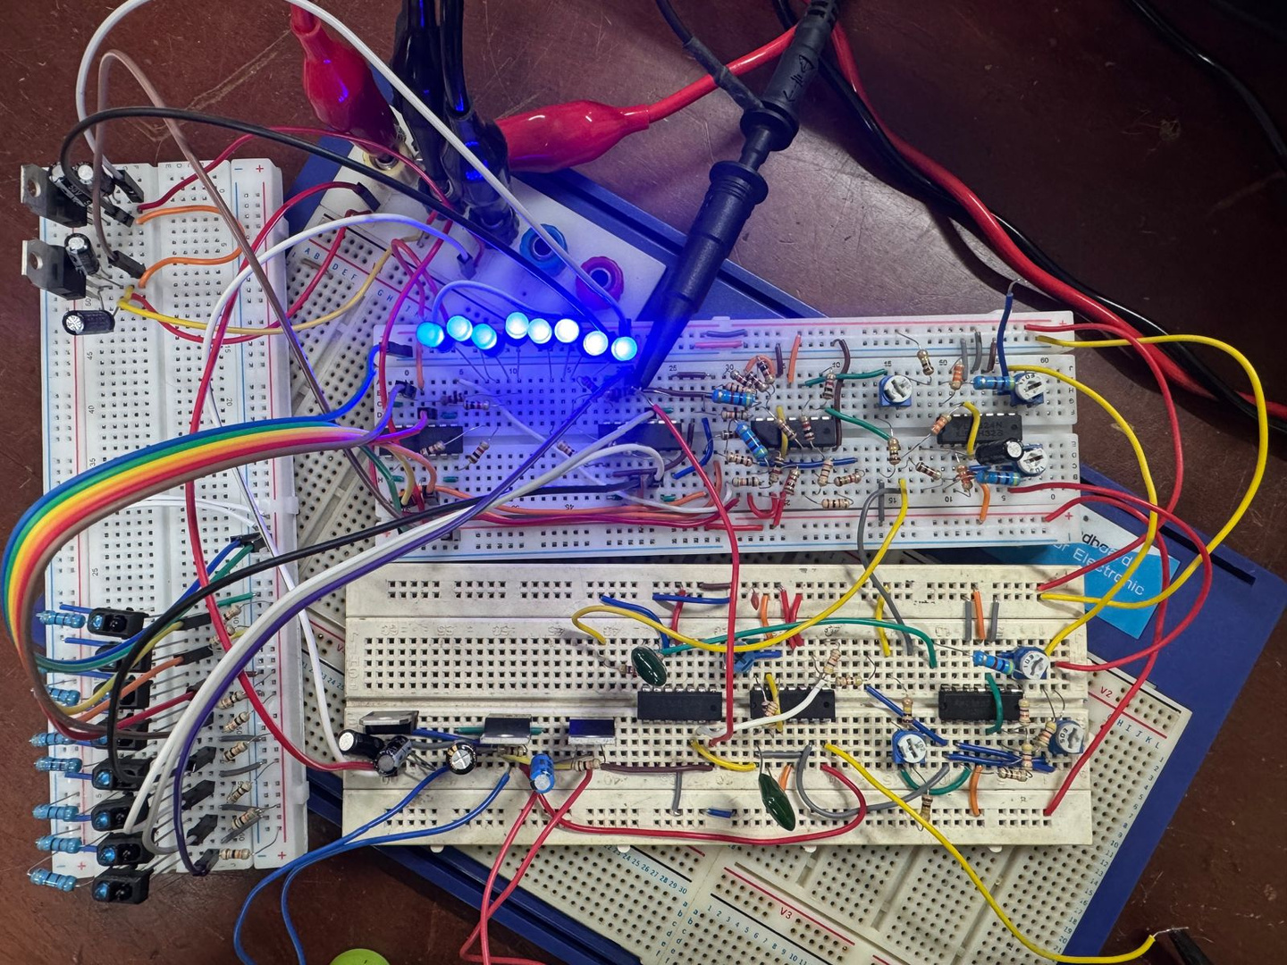
Functionality
IR Sensor Array
Function: Detects the position of the black line on a white surface.Provides analog voltage proportional to reflected light intensity.
Component: 8 IR emitter–receiver pairs.
Buffer Circuit
Function: Isolates the sensor array from the next stage and prevents signal interference.
Component: Op-amps from LM324 in voltage follower mode.
Input IR sensors and buffers

Slide 6
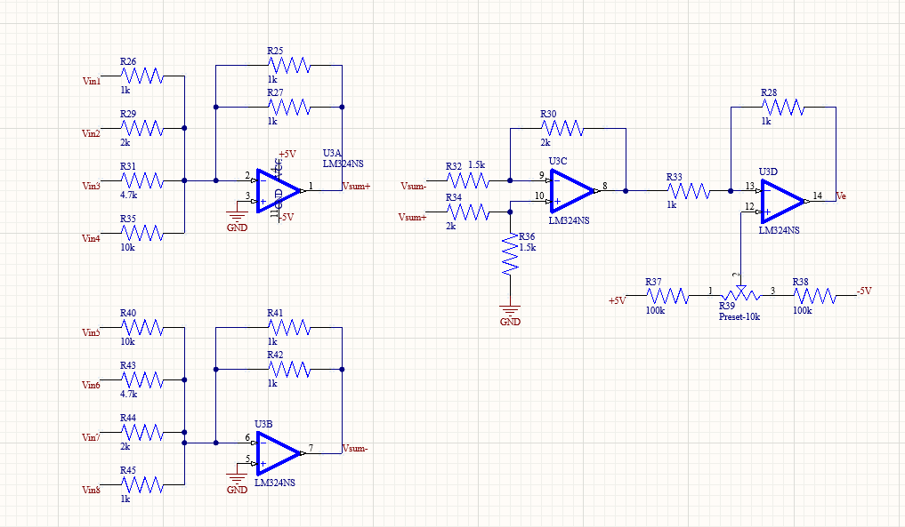
Functionality
Weighted Sum Calculation
Function: Computes position information by giving different weights to each sensor.
Component: Scaling adder circuit using op-amps and resistors.
Calculate Difference
Function: Produces the error signal by comparing left and right sums.
Component: Differential amplifier
Scaling adders and Subtractor

Slide 7
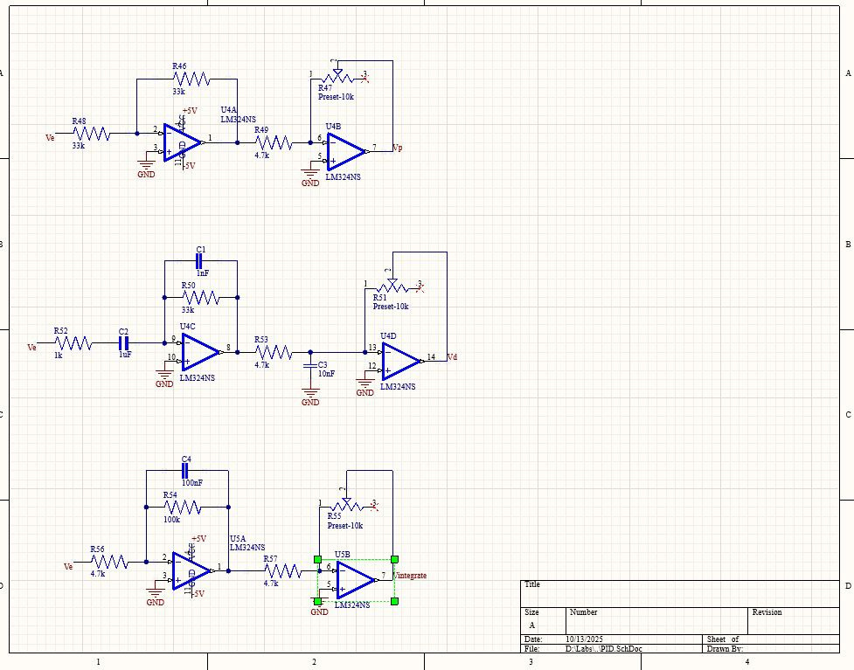
Functionality
PID Control
Proportional (P): Directly amplifies error signal.
Provides immediate correction proportional to error.
Integral (I): Integrates error over time using an op-amp integrator.
Eliminates steady-state error.
Derivative (D): Differentiates error signal using an op-amp differentiator.
Predicts and reduces overshoot.
Proportional
Derivative
Integral
PID controller

Slide 8
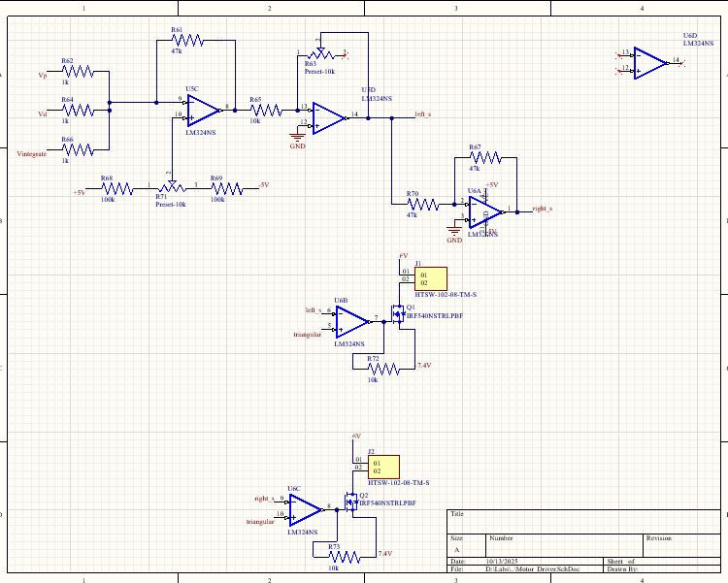
Functionality
Transistor Switch
Function: Drives DC motors based on PWM signal.
Component: Power transistors
Motors
Function: Execute movement and correction.
Component: Two DC gear motors.
Motor controlling circuit

Slide 9
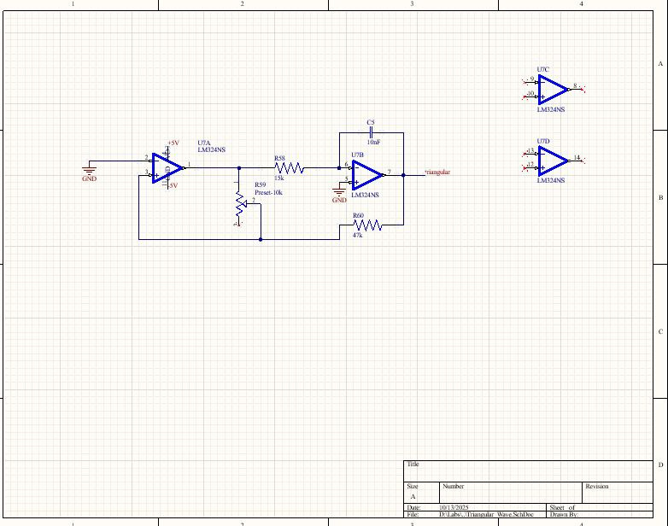
Functionality
Triangle Wave Generator
Function: Produces a periodic triangle waveform.
Component: Op-amp-based integrator + comparator.
Comparator
Function: Compares PID output with triangle wave to generate PWM.
Component: Op-amp in comparator mode.
Triangular wave generator

Slide 10
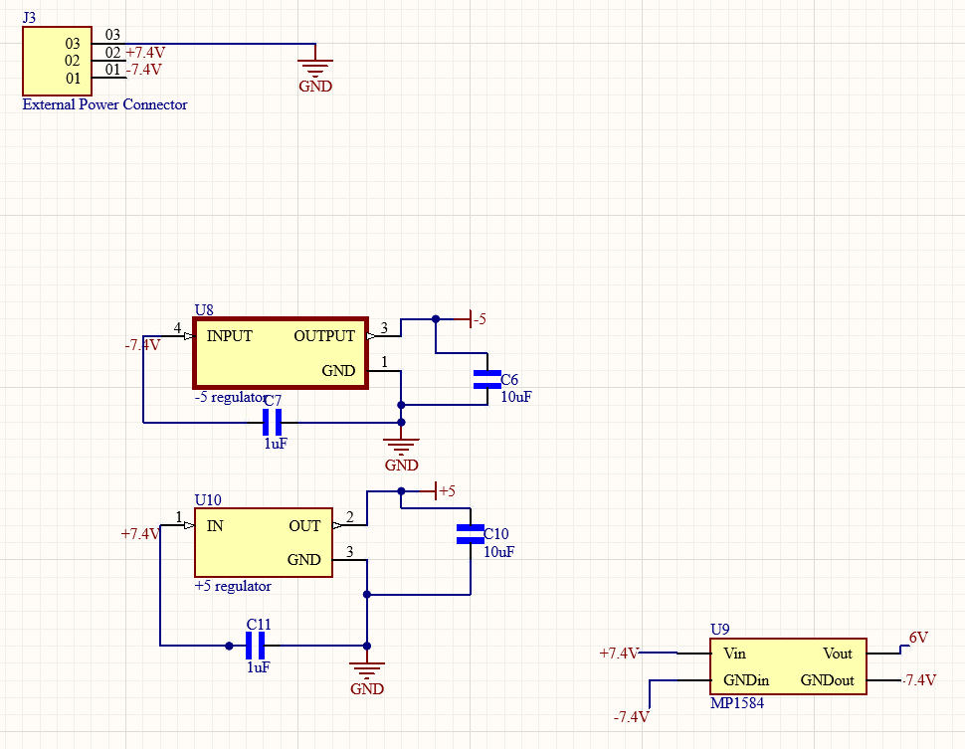

Regulators and power management circuits

Slide 11
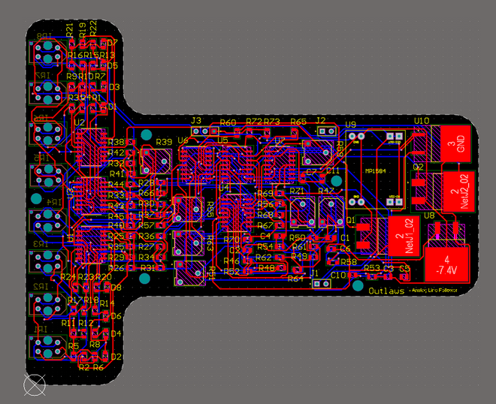
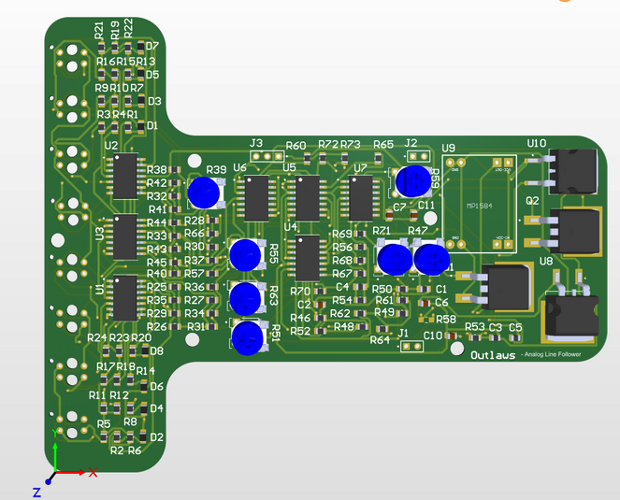
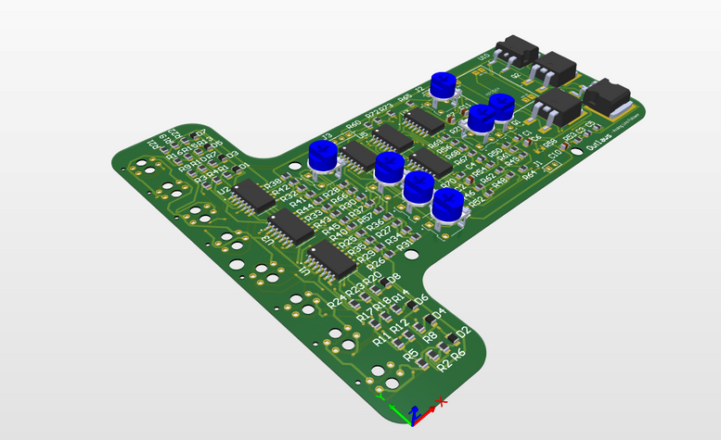
PCB Design

Slide 12
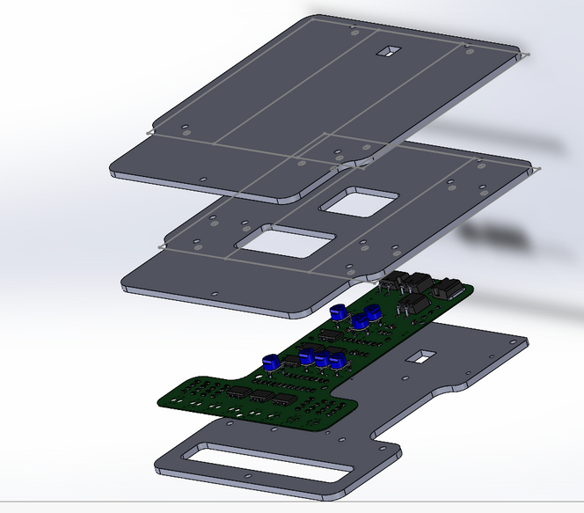
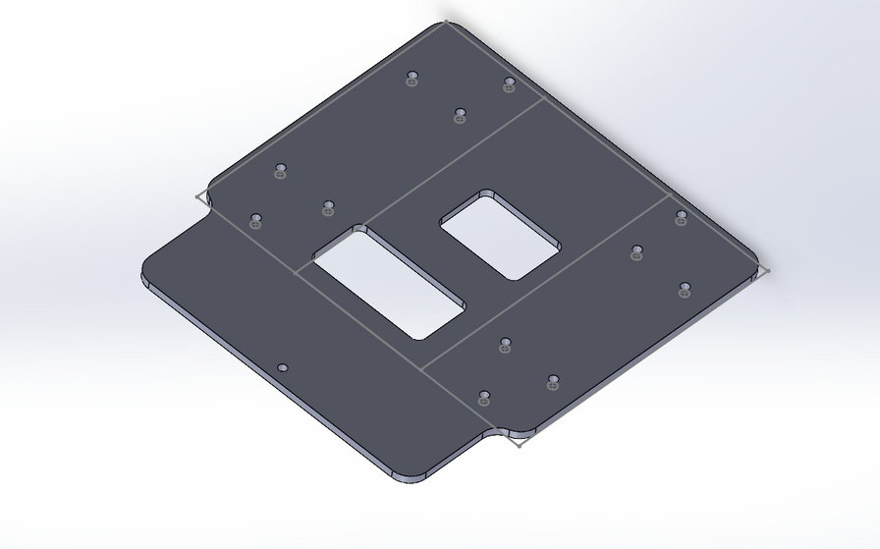
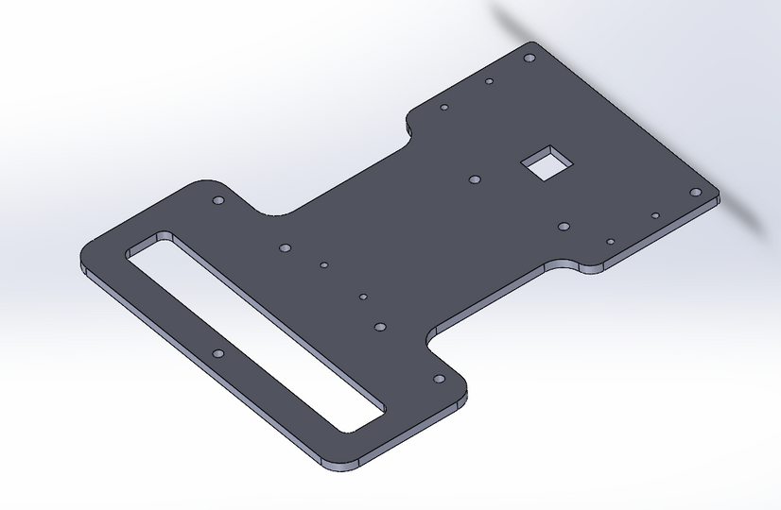
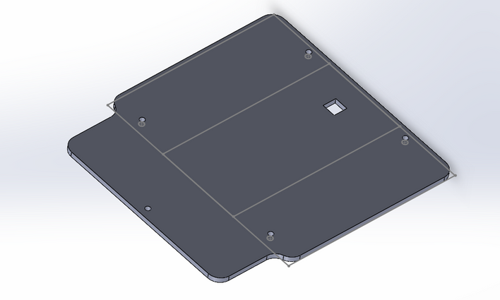
Enclosure Design

Slide 13
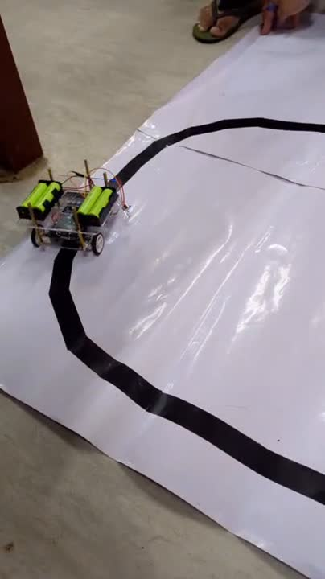

Slide 14

THANK YOU!
www.reallygreatsite.com

